Slide 1

មជ្ឈមណ្ឌលកូរ៉េ សហ្វវែរ អេច អ ឌី
Korea Software HRD Center
Java Presentation
ឣ្នកប្រឹក្សាយោបល់: បណ្ឌិត​​ គីម​ ថេខ្យុង
ឣ្នកណែនំា: លោក លាង ប៊ុនរ៉ុង
លោក ដារ៉ា ពេញចិត្ត
www.kshrd.com.kh

Slide 2
ថ្នាក់ ភ្នំពេញ
ក្រុមទី ៤
ប្រធានបទ៖ Collections
សមាជិក
លោក ហ៊ុំ វ័ន
លោក ជាគីមហៅ
លោក ស៊ាង គង្គា
លោក ជឹម មីនា
លោក គីម ប៊ុនហុង

Slide 3
មាតិកា
1. ស្វែងយល់អំពី Collections
2. ស្វែងយល់អំពី List:Vector, ArrayList, LinkedList
3. ស្វែងយល់អំពី Set: HashSet,TreeSet
4. ស្វែងយល់អំពី Map: TreeMap,HashTable

Slide 4
1. ស្វែងយល់អំពី Collections
1.1 តើអ្វីទៅជា Collections?
Collection នៅក្នុងភាសា Java គឺជា Container
Collections ជាមួយបណ្តុំនៃ Class និង Interface ជួយឲ្យអ្នកសរសេរកម្មវិធីងាយស្រួលដោះស្រាយ collection នៃ Object
ជាធម្មតា Object មួយតែងតែមានធាតុជាច្រើនដែលត្រូវបានដាក់ចូលរួមគ្នាតែមួយ (Single Unit)។
Collections ត្រូវបានប្រើប្រាស់វាដើម្បី រក្សាទុក ទាញយក រៀបចំ និង សរុបទិន្នន័យ ។
ជាទូទៅពួកវាបង្ហាញ data items ដែលជា form natural group ដូចជា game poker hand(a collection of cards),mail folder(a collection of letter) ជាដើម ។
Notes:
A collection — sometimes called a container — is simply an object that groups multiple elements into a single unit. Collections are used to store, retrieve, manipulate, and communicate aggregate data. Typically, they represent data items that form a natural group, such as a poker hand (a collection of cards), a mail folder (a collection of letters), or a telephone directory (a mapping of names to phone numbers). If you have used the Java programming language — or just about any other programming language — you are already familiar with collections.

Slide 5
1. ស្វែងយល់អំពី Collections
1.2 តើអ្វីទៅជា Collections Framework?
Collections framework គឺជាការរួមបញ្ចូល architecture សំរាប់ការបង្ហាញ និង ការប្រើប្រាស់ collections ។
ខាងក្រោមនេះគឺជា Collections framework៖
Interfaces:វាគឺជា abstract data types ដែលបង្ហាញពី Collections ។ Interface អនុញ្ញាតិឲ្យ Collections អាចត្រូវបានប្រើប្រាស់ដោយសេរីនូវការបង្ហាញពីភាពលំអិតរបស់ពួកវា ។
Implementations: វាជាការអនុវត្តជាក់ស្តែងនូវ Collections interfaces ។ ចំណុចសំខាន់របស់វាគឺអាចប្រើប្រាស់ឡើងវិញនៅ data structure ។
Notes:
A collection — sometimes called a container — is simply an object that groups multiple elements into a single unit. Collections are used to store, retrieve, manipulate, and communicate aggregate data. Typically, they represent data items that form a natural group, such as a poker hand (a collection of cards), a mail folder (a collection of letters), or a telephone directory (a mapping of names to phone numbers). If you have used the Java programming language — or just about any other programming language — you are already familiar with collections.

Slide 6
1. ស្វែងយល់អំពី Collections
Algorithms:វាគឺជា methods ដែលអនុវត្តការគណនាដ៏មានប្រយោជន៍ ដូចជា ការស្រាវជ្រាវ និង រៀបចំ នៅលើ Object ដែលអនុវត្តនូវលើ collection interfaces ។ Algorithms ត្រូវបានគេហៅថា polymorphic ដែលដូចគ្នាទៅនឹង methods ដែលអាចធ្វើបានច្រើនទំរង់ទៅតាម collections interfaces ។ ចំណុចសំខាន់របស់វាគឺអាចប្រើប្រាស់ឡើងវិញនៅ functionality ។
Notes:
A collection — sometimes called a container — is simply an object that groups multiple elements into a single unit. Collections are used to store, retrieve, manipulate, and communicate aggregate data. Typically, they represent data items that form a natural group, such as a poker hand (a collection of cards), a mail folder (a collection of letters), or a telephone directory (a mapping of names to phone numbers). If you have used the Java programming language — or just about any other programming language — you are already familiar with collections.

Slide 7
1. ស្វែងយល់អំពី Collections
1.3 គុណសម្បត្តិនៃ Collections Framework
Reduces programming effort:វាបានផ្តល់នូវ data structure និង algorithms ដូច្នេះអ្នកមិនចាំបាច់ខ្វាយខ្វល់ និង ផ្តោតទៅលើកិច្ចការដែលអ្នកធ្វើនោះបានហើយ ។ វាបានជួយសម្រួលដល់ API មួយចំនួនដែលមិនទាក់ទង ដោយផ្តល់ឲ្យដោយមិនចាំបាច់សរសេរ adapter object ឬ បំលែងកូដដើម្បី connect API ឡើយ ។
Increases program speed and quality: វាបានផ្តល់នូវ high-performance high-quality ដល់ការអនុវត្តនៃ data structure និង algorithms ឲ្យកាន់តែល្អ ។ មានន័យថា អ្នកសរសេរកម្មវិធីមិនបាច់ហត់នឿយទៅអង្គុយសរសេរ structure ដោយខ្លួនឯង ហើយយើងនឹងមានពេលវេលាច្រើនដើម្បីធ្វើឲ្យកម្មវិធីរិតតែប្រសើរឡើង ។
Notes:
A collection — sometimes called a container — is simply an object that groups multiple elements into a single unit. Collections are used to store, retrieve, manipulate, and communicate aggregate data. Typically, they represent data items that form a natural group, such as a poker hand (a collection of cards), a mail folder (a collection of letters), or a telephone directory (a mapping of names to phone numbers). If you have used the Java programming language — or just about any other programming language — you are already familiar with collections.

Slide 8
1. ស្វែងយល់អំពី Collections
Allows interoperability among unrelated APIs: Collection interfaces វាជាការសរសេរនៅក្នុងផ្នែកណាមួយហើយ API ភ្ជាប់ collection ទៅវិញទៅមក ។ សរុបមកគឺនឹងភ្ជាប់ network ឲ្យ API បានស្គាល់គ្នា ។
Notes:
A collection — sometimes called a container — is simply an object that groups multiple elements into a single unit. Collections are used to store, retrieve, manipulate, and communicate aggregate data. Typically, they represent data items that form a natural group, such as a poker hand (a collection of cards), a mail folder (a collection of letters), or a telephone directory (a mapping of names to phone numbers). If you have used the Java programming language — or just about any other programming language — you are already familiar with collections.

Slide 9
1. ស្វែងយល់អំពី Collections
1.3 ប្រភេទនៃ Collections?
Java ផ្តល់ឲ្យនៅប្រភេទនៃ Collections មួយចំនួនដូចជា៖
List: ArrayList , LinkedList, Vector
Set: HashSet , LinkedHashSet,TreeSet
Map: HashMap, TreeMap , LinkedHashMap
Notes:
Java supplies several types of Collection:
Set: cannot contain duplicate elements, order is not important
SortedSet: like a Set, but order is important
List: may contain duplicate elements, order is important
Java also supplies some “collection-like” things:
Map: a “dictionary” that associates keys with values, order is not important
SortedMap: like a Map, but order is important
While you can get all the details from the Java API, you are expected to learn (i.e. memorize):
The signatures of the “most important” methods in each interface
The most important implementations of each interface

Slide 10
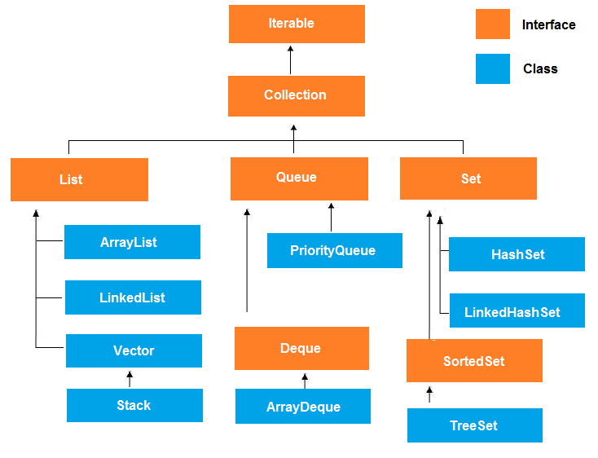
1. ស្វែងយល់អំពី Collections
Notes:
Java supplies several types of Collection:
Set: cannot contain duplicate elements, order is not important
SortedSet: like a Set, but order is important
List: may contain duplicate elements, order is important
Java also supplies some “collection-like” things:
Map: a “dictionary” that associates keys with values, order is not important
SortedMap: like a Map, but order is important
While you can get all the details from the Java API, you are expected to learn (i.e. memorize):
The signatures of the “most important” methods in each interface
The most important implementations of each interface

Slide 11
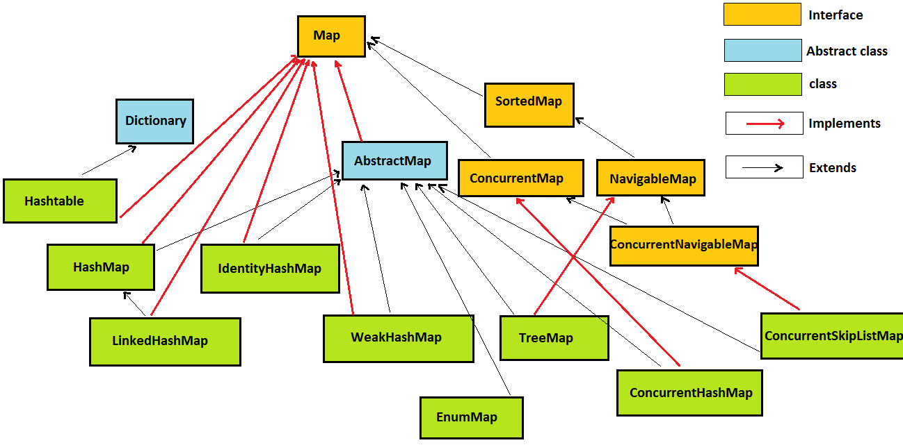
1. ស្វែងយល់អំពី Collections

Slide 12
2.1 List Interface
2. ស្វែងយល់អំពី List: Vector , ArrayList, LinkedList
Generate result តាម insertion order.
វា Support duplicity
វា Support indexing មានន័យថាយើងអាច insert element តាម index ជាក់លាក់បាន។
វាអាច synchronized និងមិន synchronized បានទាំងពីរ.

Slide 13
2.1 List Interface
2. ស្វែងយល់អំពី List: Vector , ArrayList, LinkedList
value
index
“Paul”
“Mark”
“John”
“Paul”
“Luke”
0
1
2
3
4
A List cares about the index.
ArrayList
Vector
LinkedList
Notes:
Notes:
A list cares about the index. The one thing that List has that non-lists don’t have is a set of methods related to the index. All three List implementations are ordered by index position – a position that you determine either by setting an object at a specific index or by adding it without specifying position, in which case the object is added to the end.
Transition:
Click ArrayList to view the sample solution.
Click Vector to view the sample solution.
Click Linked List to view the sample solution.
Click the Red Area to go back to the previous slide.

Slide 14

Fast iteration and fast random access
Vector
ArrayList
List
It's like a slower ArrayList, but it has synchronized methods
Good for adding elements to the ends, i.e. stacks and queues
LinkedList

Slide 15
2.2.1 Vector
2. ស្វែងយល់អំពី List: Vector , ArrayList, LinkedList
វាត្រូវបានប្រើតាំងពី Java versoin 1.0 មក។
Generate result តាម insertion order.
វា support duplicity.
វា Increase capacity size ពីរដងនៃ capacity ដើមវា
វាត្រូវបានគេស្គាល់ថាជា legacy class(old class) .
វាមានលក្ខណៈ synchronized ឬ thread-safe.
ដោយសារវាមានលក្ខណៈ synchronization វាធ្វើអោយ Process slow ដូច្នេះគេមិនសូវបានប្រើវាទេ។
វាមានលក្ខណៈ dynamic

Slide 16
2.2.1 Vector
2. ស្វែងយល់អំពី List: Vector , ArrayList, LinkedList
Public static void main(String arg[]){
Vector v=new vector();
For(int i=0; i<=10; i++){
v.addelement(i);}
System.out.print(al); //0,1,2……..10;
Enumeration e= v.element();
While(itr.hasNextElement()){
Integer in=(Integer)itr.nextElement();
If(in%2==0)
System.out.println(in); //0,2,4,6,8,10
}
System.out.print(al); //0,1,2……..10
}

Slide 17
2.3 Arraylist
2. ស្វែងយល់អំពី List: Vector , ArrayList, LinkedList
ប្រើលក្ខណៈ Dynamic​ Array ដើម្បី store element(ផ្ទុកធាតុ)។
អាចផ្ទុក Duplicate element(ធាតុស្ទូន)។
Maintain insertion order​​ (តាមលំដាប់លំដោយ)។
Non synchronized
អនុញ្ញាតការ​ Random access​ ព្រោះវាធ្វើការជាលក្ខណ index។
យើងអាច Iterate element នៃ collection ក្នុង Java តាម២របៀបគឺ:
Iterator interface & For-each Loop

Slide 18
2.3 Arraylist
2. ស្វែងយល់អំពី List: Vector , ArrayList, LinkedList
Syntax:
Arraylist<String> al= new Arraylist<String>();

Slide 19
2.3 Arraylist
2. ស្វែងយល់អំពី List: Vector , ArrayList, LinkedList
Public static void main(String arg[]){
ArrayList al=new ArrayList();
For(int i=0; i<=10; i++){
al.add(i);}
System.out.print(al); //0,1,2……..10;
Iterator itr=al.iterator();
While(itr.hasNext()){
Integer in=(Integer) itr.next();
If(in%2==0)
System.out.println(in); //0,2,4,6,8,10
Else
itr.remove();
}
System.out.print(al); //0,2,4,6,8,10
}

Slide 20
2.3.1 Vector VS Arraylist
2. ស្វែងយល់អំពី List: Vector , ArrayList, LinkedList
ArrayList | Vector
1) ArrayList is not synchronized. | Vector is synchronized.
2) ArrayList increments 50% of current array size if number of element exceeds from its capacity. | Vector increments 100% means doubles the array size if total number of element exceeds than its capacity.
3) ArrayList is not a legacy class, it is introduced in JDK 1.2. | Vector is a legacy class.
4) ArrayList is fast because it is non-synchronized. | Vector is slow because it is synchronized i.e. in multithreading environment, it will hold the other threads in runnable or non-runnable state until current thread releases the lock of object.
5) ArrayList uses Iterator interface to traverse the elements. | Vector uses Enumeration interface to traverse the elements. But it can use Iterator also.

Slide 21
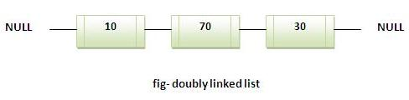
2.4 Linked List
2. ស្វែងយល់អំពី List: Vector , ArrayList, LinkedList
ប្រើ​លក្ខណDoubly linked list ដើម្បី​ store element។
អាចផ្ទុក Duplicate element(ធាតុស្ទូន)។
Maintain insertion order​​ (តាមលំដាប់លំដោយ)។
Non synchronized។
អាចប្រើជា​ List លក្ខណ ​stack queue។

Slide 22
2.4.1 Linked List VS ArrayList
2. ស្វែងយល់អំពី List: Vector , ArrayList, LinkedList
ArrayList | LinkedList
1) ArrayList internally uses dynamic array to store the elements. | LinkedList internally uses doubly linked list to store the elements.
2) Manipulation with ArrayList is slow because it internally uses array. If any element is removed from the array, all the bits are shifted in memory. | Manipulation with LinkedList is faster than ArrayList because it uses doubly linked list so no bit shifting is required in memory.
3) ArrayList class can act as a list only because it implements List only. | LinkedList class can act as a list and queue both because it implements List and Deque interfaces.
4) ArrayList is better for storing and accessing data. | LinkedList is better for manipulating data.

Slide 23
3.1 Set Interface
3. ស្វែងយល់អំពី Set: HashSet , TreeSet
វាមានតាំងពី Java 1.2
វាមិនអនុញ្ញាតអោយមាន Dupplicate ទេ ប៉ុន្តែបើយើងអោយមានតម្លៃ Dupplicate ក៏វាមិនមាន Error កើតឡើងដែរ
វាមិន support indexing ទេ។ មានន័យថា វាមិនមានការ insert និង delete elements តាម index ណាមួយឡើយ។

Slide 24
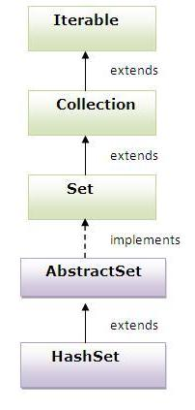
3.1.1 Hierarchy of HashSet class:
3. ស្វែងយល់អំពី Set: HashSet , TreeSet

Slide 25
3.1.1 Set Interface
3. ស្វែងយល់អំពី Set: HashSet , TreeSet
“John”
“Luke”
“Paul”
“Mark”
“Fred”
“Peter”
A Set cares about uniqueness, it doesn’t allow duplicates.
HashSet
LinkedHashSet
TreeSet
Notes:
Notes:
A Set cares about uniqueness – it doesn’t allow duplicates. Your good friend the equals( ) method determines whether two objects are identical (in which case only one can be in the se). The three Set implementations are described in the following sections.
Transition:
Click on the HashSet to view the sample solution.
Click on the LinkedHashSet to view the sample solution.
Click on the TreeSet to view the sample solution.
Click the Green Area to go back to the previous slide.

Slide 26
3.2 HashSet class
3. ស្វែងយល់អំពី Set: HashSet , TreeSet
វាត្រូវបានប្រើតាំងពី Java Version 1.2 ម្លេះ។
វាមិន Support Dupplicate ទេ។
It doesn't guarantee any order for generating result even it does not guarantee that the order will remain constant over time.
វាអនុញ្ញាតអោយមាន null ជា element។ មានន័យថាវាមិនមាន NullPointerException កើតឡើងទេពេលមាន element ជា Null
វាត្រូវការនូវ Hashtable class ដើម្បី holding elements របស់វា។
វាមិនមានលក្ខណៈជា synchronized ទេតែយើងអាចធ្វើអោយវា synchronized បានទៅតាមតម្រូវការ។
ប្រើនូវ hashtable ដើម្បី store នូវ elements របស់វា។
វា extends ចេញពី AbstractSet class និង implements ចេញពី Set interface.
ផ្ទុកតែ unique elements តែប៉ុណ្ណោះ។

Slide 27
3.2 HashSet class (continue)
3. ស្វែងយល់អំពី Set: HashSet , TreeSet
import java.util.*;
class TestCollection9{
public static void main(String args[]){
HashSet<String> al=new HashSet<String>();
al.add("Ravi");
al.add("Vijay");
al.add("Ravi");
al.add("Ajay");
Iterator<String> itr=al.iterator();
while(itr.hasNext()){
System.out.println(itr.next());
}
}
}
Vijay Ravi Ajay

Slide 28
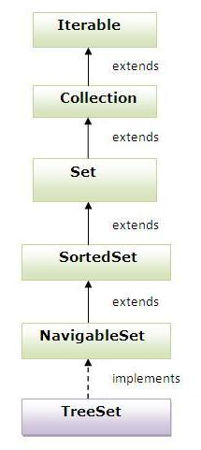
3.3 TreeSet class
3. ស្វែងយល់អំពី Set: HashSet , TreeSet
វាត្រូវបានប្រើតាំងពី Java version 1.2 មក។
វាមិន support នូវ duplicacy ទេ។
វា generate នូវការ Order នៃតម្លៃជាលក្ខណៈ ascending តែយើងក៏អាចអោយវា generate តាម descending បានដែរ។
វាផ្ទុកតែ unique elements ដូច HashSet ដែរ។
វា implements ចេញពី NavigableSet interface ដែល extends ពី SortedSet interface.

Slide 29
3.3 TreeSet class
3. ស្វែងយល់អំពី Set: HashSet , TreeSet
import java.util.*;
class TestCollection11{
public static void main(String args[]){
TreeSet<String> al=new TreeSet<String>();
al.add("Ravi");
al.add("Vijay");
al.add("Ravi");
al.add("Ajay");
Iterator<String> itr=al.iterator();
while(itr.hasNext()){
System.out.println(itr.next());
}
}
}
Ajay Ravi Vijay

Slide 30
4. Map Interface
4. ស្វែងយល់អំពី Map: TreeMap , HashTable
វាមានតាំងពី Java 1.2មក។
វាធ្វើការលក្ខណៈជា key-value paired techniques(Hashing techniques).
វាមិនអាចមាន duplicate បានទេប៉ុន្តែវាអាចមាន duplicate values.
វាមិនមានលក្ខណៈsynchronized​ ទេ។

Slide 31
4. Map Interface
4. ស្វែងយល់អំពី Map: TreeMap , HashTable

Slide 32
4. Map Interface
4. ស្វែងយល់អំពី Map: TreeMap , HashTable
key
value
“Pl”
“Ma”
“Jn”
“ul”
“Le”
“Paul”
“Mark”
“John”
“Paul”
“Luke”
A Map cares about unique identifiers.
HashMap
Hashtable
LinkedHashMap
TreeMap
Notes:
Notes:
A Map cares about unique identifiers. You map a unique key (the ID) to a specific value, where both the key and the values are of course objects. You’re probably quite familiar with Maps since many languages support data structures that use key/value or name/value pair. Where the keys land in the Map is based on the key’s hashcode, so, like HashSet, the more efficient your hashCode( ) implementation, the better access performance you’ll get. The Map implementations let you do things like search for a value based on the key, as for a collection of just the values, or ask for a collection of just the keys.
Transition:
Click on the HashMap to view the sample solution.
Click on the Hashtable to view the sample solution.
Click on the LinkedHashMap to view the sample solution.
Click on the TreeMap to view the sample solution.
Click the Blue Area to go back to the previous slide.

Slide 33
Map World
Like a slower HashMap (as with Vector, due to its synchronized methods). No null values or null keys allowed
Treemap
A sorted map
Hashtable
Fastest updates (key/values); allows one null key, many
null values
Map
Faster iterations; iterates by insertion order or last accessed; allows one null key, many null values
HashMap
LinkedHashMap

Slide 34
4. ស្វែងយល់អំពី Map: TreeMap , HashTable
4.1. TreeMap
គឺជា class ដែល implements ចេញពី NavigableMap interface និង​extends ចេញពី​ AbstractMap class
វាផ្ទុកនូវ value ដោយផ្អែកលើ key របស់វា
វាមិនអាចគ្មាន keyទេ តែអាចគ្មាន Value បាន
វាផ្ទុកបានតែ unique elements ប៉ុណ្ណោះ
វាតម្រៀបជា ascending

Slide 35
4. ស្វែងយល់អំពី Map: TreeMap , HashTable
4.1.1 Constructor របស់ TreeMap
TreeMap(): ជា constructor ដែលប្រើដើម្បីបង្កើត empty tree map ដែលតម្រៀបលក្ខណៈ ascending តាម key value របស់វា។
TreeMap(Comparator comp): ប្រើដើម្បីបង្កើត empty tree-based map ដែលតម្រៀបតាម Comparator comp។
TreeMap(Map m): constructor នេះគឺ ផ្តល់តម្លៃទៅអោយ tree map ជាមួយនឹងធាតុ m ដែលវានឹងតម្រៀបលក្ខណៈ ascending តាម key value របស់វា។
TreeMap(SortedMap sm): វាផ្តល់តម្លៃទៅអោយ tree map ជាមួយនឹងធាតុពី SortedMap sm ដែលវាតម្រៀបដូចនឹង sm ដែរ។

Slide 36
4. ស្វែងយល់អំពី Map: TreeMap , HashTable
4.2 Methods របស់ TreeMap
Method | Desciption
void Clear() | remove all mapping from this treemap
Object Clone() | return a shallow copy របស់​ TreeMap instance
Comparator comparator() | return comparator ដែលប្រើដើម្បីតម្រៀប
Boolean containsKey (object key) | Return true បើ​treemap នេះមានផ្ទុកនូវ specified key ដែល​ mapping
Boolean containsValue(object value) | Return true បើ treemap នេះ map ទៅកាន់ keyមួយឬច្រើនដែលមាន specified valueនេះ
Set entrySet() | Return a set view of the mapping contained in this map.

Slide 37
4. ស្វែងយល់អំពី Map: TreeMap , HashTable
4.3 HashTable
HashTable implements ពី Map Interface និង​ extends ពី Dictionary Class
វាផ្ទុកនូវ value ដោយពឹងផ្អែកលើ key
វាផ្ទុកតែ​ unique elements
វាដូចនឹង HashMap ដែរតែខុសត្រង់វាគឺ synchronized
វាមិនតម្រៀបដូចទៅនឹង TreeMap ទេ

Slide 38
4. ស្វែងយល់អំពី Map: TreeMap , HashTable
4.3 Methods របស់ HashTable
Method | Desciption
void clear() | remove key value ទាំងអស់ពិ​hashtable
Object Clone() | return a shallow copy ពី hashtable នេះ
boolean contains(Object value) | Test បើ​ key map ទៅកាន់specified value
boolean isEmpty() | Test បើ hashtable maps គ្មាន keyទៅកាន់value
Enumeration keys() | Return នូវការរាប់ឈ្មោះនៃ keys ដែលមានក្នុង hashtable
Object put(object key,object value) | Maps នុវ specified key ទៅកាន់specified value

Slide 39
4. ស្វែងយល់អំពី Map: TreeMap , HashTable
4.3 Methods របស់ HashTable
Method | Desciption
void rehash() | តម្លើងទំហំនៃ hashtableនិងតម្លើង keys ទាំងអស់របស់វា
object remove(object key) | remove keyនិង​ value របស់ key នោះ
int size() | Return ចំនួន key-value ដែលកំពុង map
String toString() | Return string ដែលសមមូល
Boolean containKey(Object key) | Test បើ specified object គឺជា keyក្នុង hashtable
Boolean containValue(object value) | Test បើ specified object គឺជា valueក្នុង hashtable។​ return false ពេលមិនមានvalue ណាស្មើរ

Slide 40
4. ស្វែងយល់អំពី Map: TreeMap , HashTable
4.3 Methods របស់ HashTable
Method | Desciption
Enumeration elements() | Return នូវការរាប់ឈ្មោះនៃ value ដែលមានក្នុង hashtable
object get(object key) | remove keyនិង​ value របស់ key នោះ

Slide 41
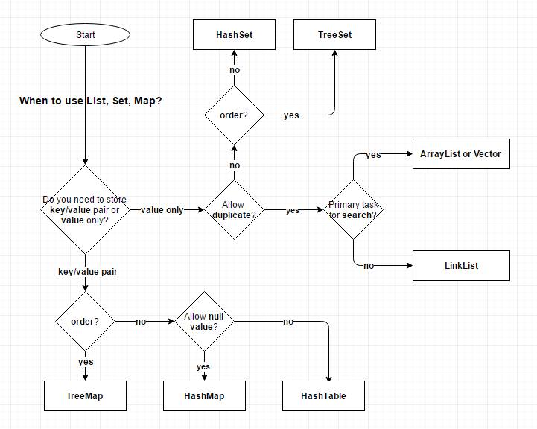
4. ស្វែងយល់អំពី Map: TreeMap , HashTable
4.4 សង្ខេបនៃការប្រើប្រាស់ Collections

Slide 42
ប្រភពឯកសារ
http://tutorials.jenkov.com/java-collections/index.html
http://www.javatpoint.com/Map-interface-in-collection-framework
http://www.javamadesoeasy.com/2015/04/arraylist-in-java.html
http://www.javamadesoeasy.com/2015/04/arraylist-in-java.html
http://hackersstudy.tistory.com/26
http://www.javaperspective.com/collections.html
https://developer.apple.com/library/ios/documentation/Swift/Conceptual/Swift_Programming_Language/CollectionTypes.html
https://docs.oracle.com/javase/tutorial/collections/intro/
http://www.javatpoint.com/collections-in-java

Slide 43
សូមអរគុណ!!!

